Slide 1
Real world analysis 2

Slide 2
Preparation for replication assignment

Slide 3
Stuff you asked for
Ancova with baseline
Anova for pre-post change scores
Anova 2x2 between subjects
Hierarchical multiple regression
Regression to test moderation
Post-hoc contrasts between groups
Cohen's D for group differences
Independent samples t test
Paired sample t test
Mann Whitney U
Chi square to test contingency table
Levene's test (equality of variances)
Cronbach's alpha

Slide 4
Model specification Anova/Ancova/Regression
Anova is regression same thing, different presentation
Ancova is also regression

Slide 5
Anova formulae
outcome ~ A
outcome ~ A * B
A and B are factors (groupings)
Run lm and store result
Then use anova(…)
You get a table like this…

Slide 6
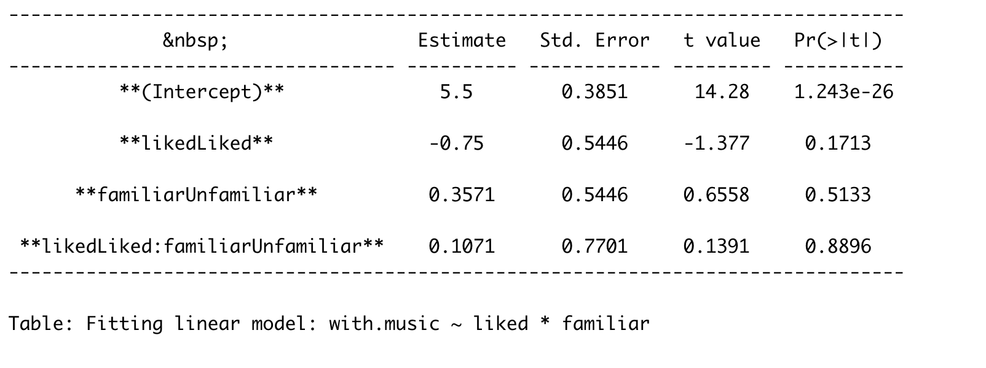
lm(with.music ~ liked * familiar, data=painmusic)

Slide 7
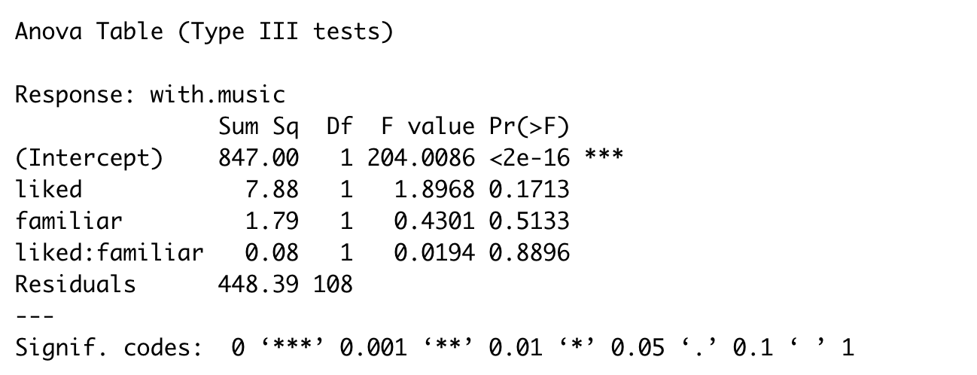
car::Anova(savedmodel)

Slide 8
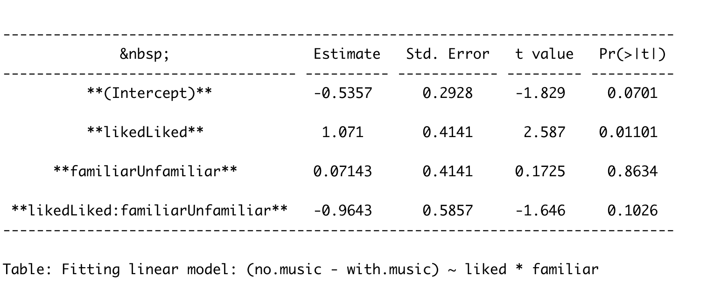
Change scores as the outcome
(no.music - with.music) ~ liked * familiar

Slide 9
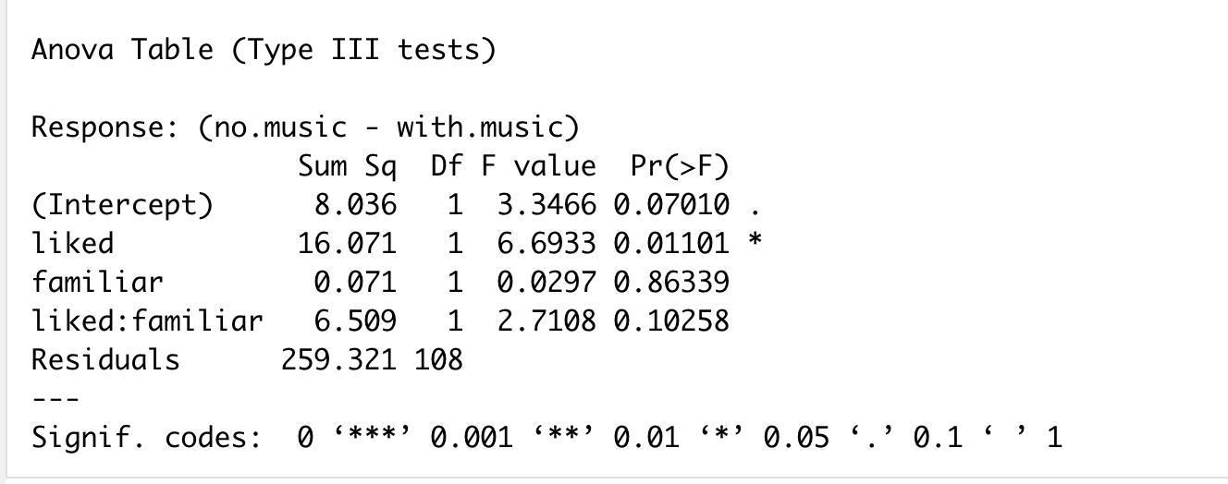
car::Anova(savedmodel)

Slide 10
Benefits of the car::Anova table
Model coefficients are confusing with > 2 groups
Omnibus tests are one method of controlling for multiple comparisons
So embedded, gives people a ‘feel’ (perhaps overstated)
Clear APA guidelines for reporting them.
car::Anova gives the ‘correct’ sums of squares

Slide 11
Ancova
Like Anova, but with Covariates
Lots of different language: “control for”, “adjust for”, ‘hold constant” “covary on”…
Still just regression but with:
At least one factor
At least one continuous predictor

Slide 12
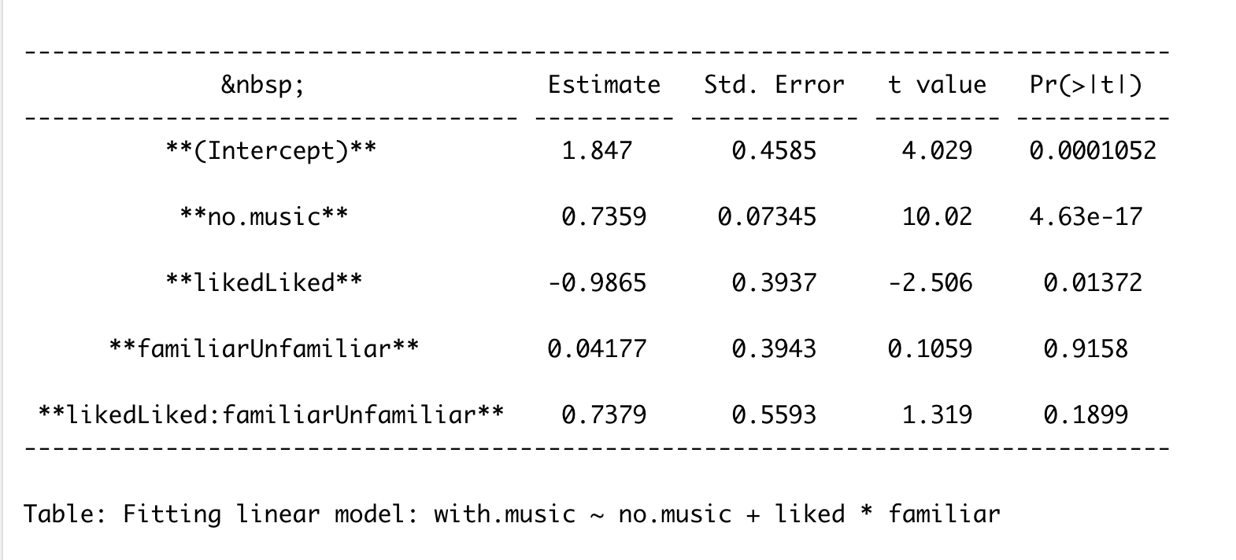
with.music ~ no.music + liked * familiar

Slide 13
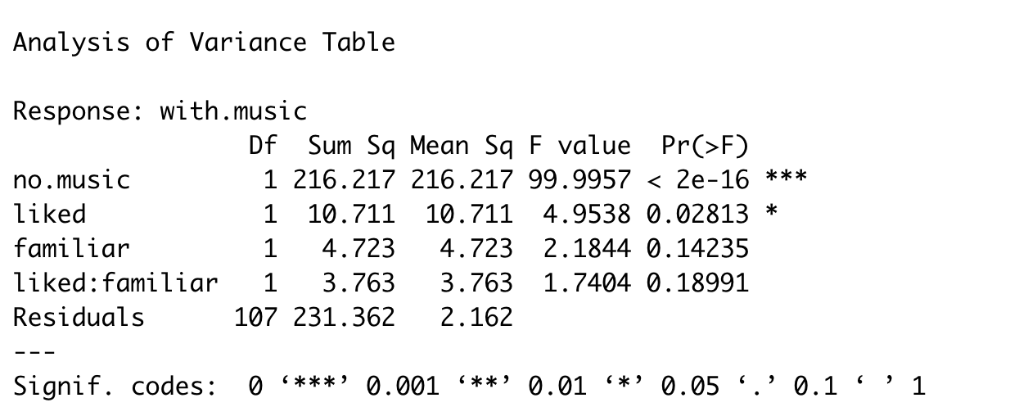
anova(lmmodelwhichisreallyanancova)

Slide 14
Ancova vs Anova Results

Slide 15
Sums of squares
ONLY matters if your model has an interaction term (e.g. `y ~ A*B`)
Concerns which model your full model is compared to
SPSS hid the choice (type 3 was the default)
Most people use type 3 out of habit but
Some good reasons to use type 2
car:Anova is the easiest way of getting type III
Important to remember if you want to replicate F and p values
Don’t sweat it: If result not ‘significant’ both ways have bigger problems.

Slide 16
Other uses of Ancova
gapminder data
Want to estimate/compare lifeExp in different continents
Ask ‘what if’ questions

Slide 17
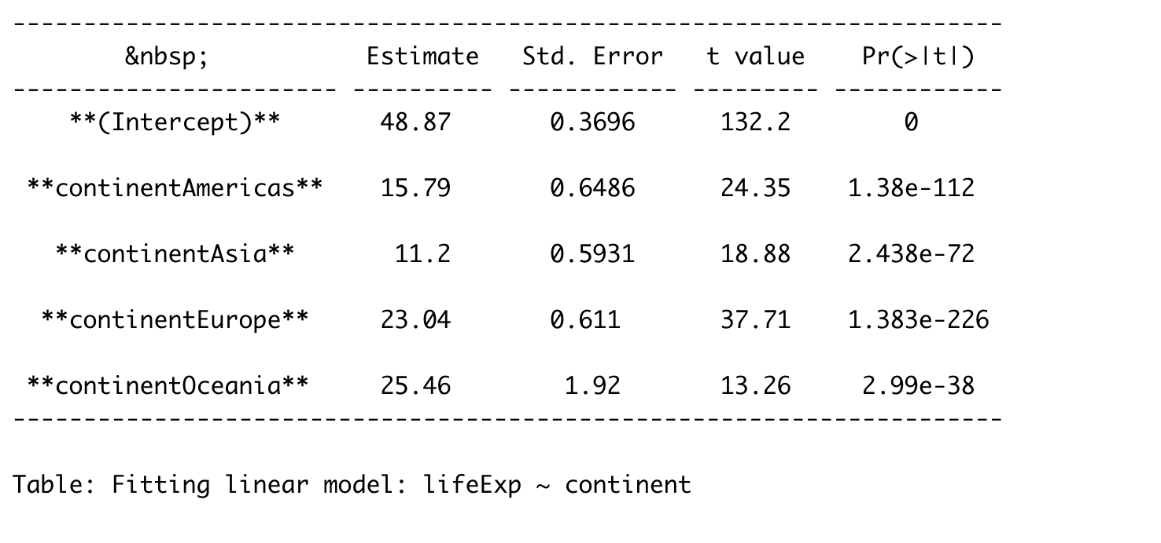
lifeExp ~ continent

Slide 18
Gapminder
But, what if different continents have different average GDP?
If we’re interested in the differences between continents, maybe we’d like to eliminate or ‘partial out’ or ‘control for’ GDP effects?
Counterfactual: If all continents had the same GDP, would there still be differences in life expectancy?
Use Ancova… maybe(!)

Slide 19
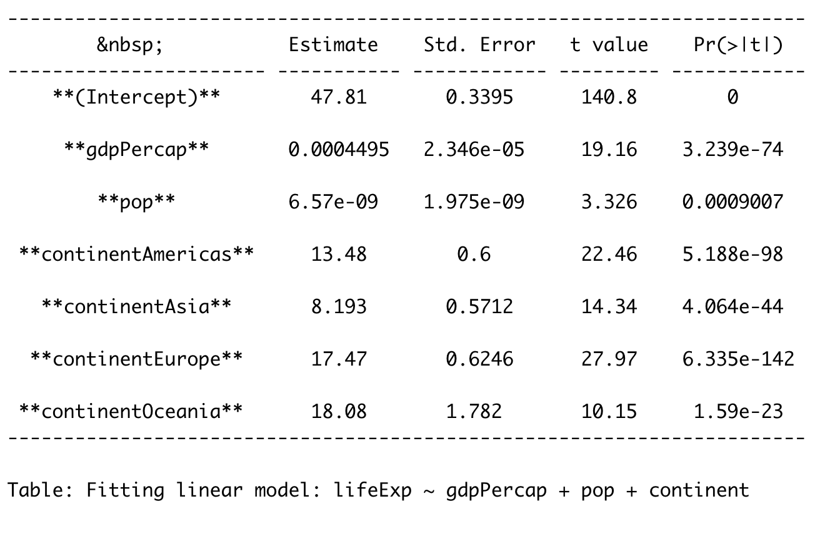
lifeExp ~ gdpPercap + pop + continent

Slide 20
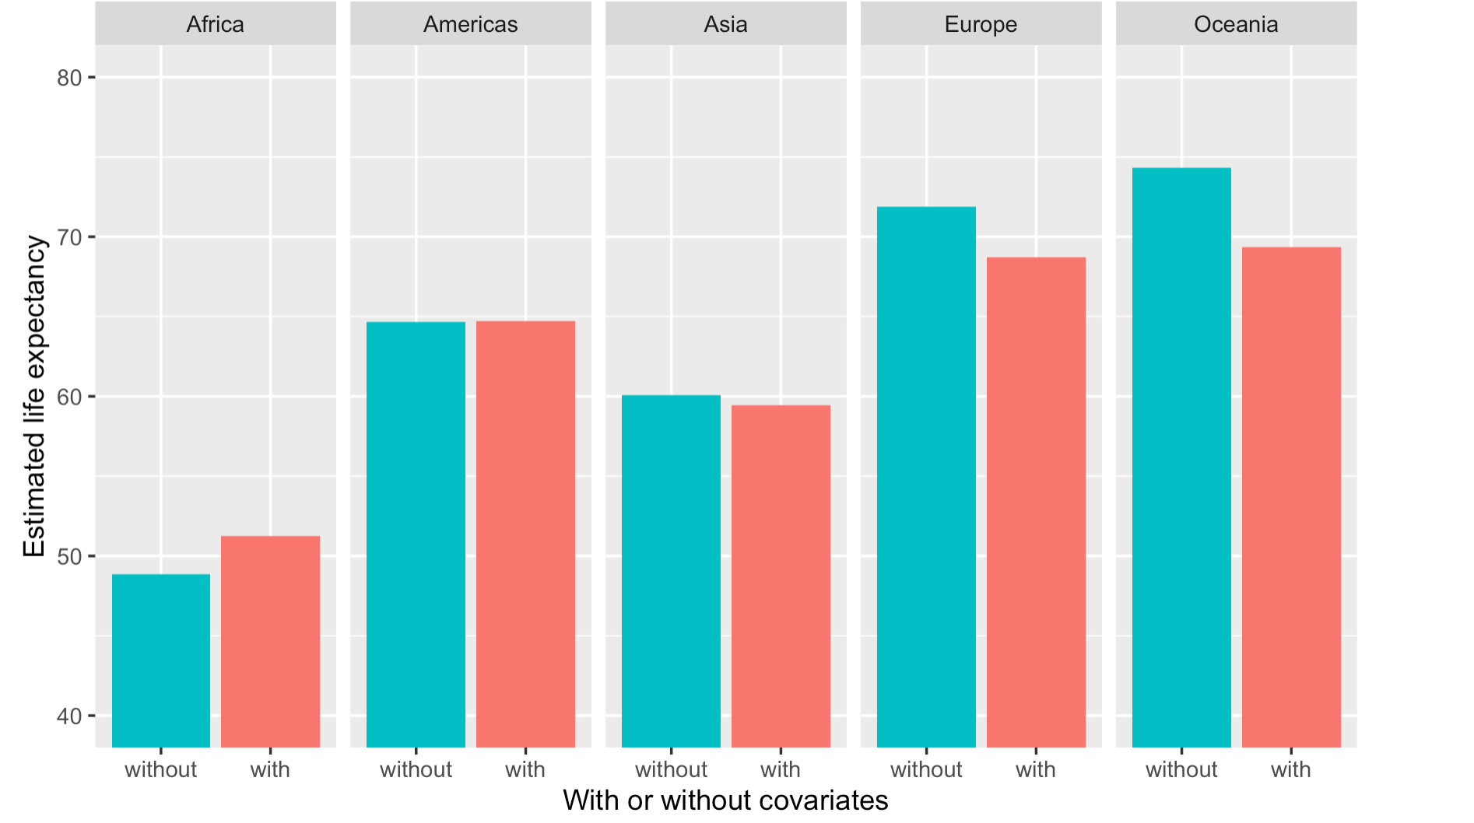

Slide 21
Based on the plot….
It looks like “controlling for GDP” removes some, but not all, of the differences between continents.

Slide 22
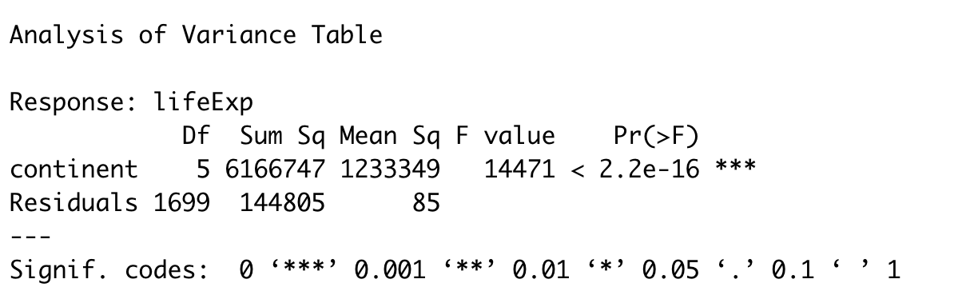
Anova table

Slide 23
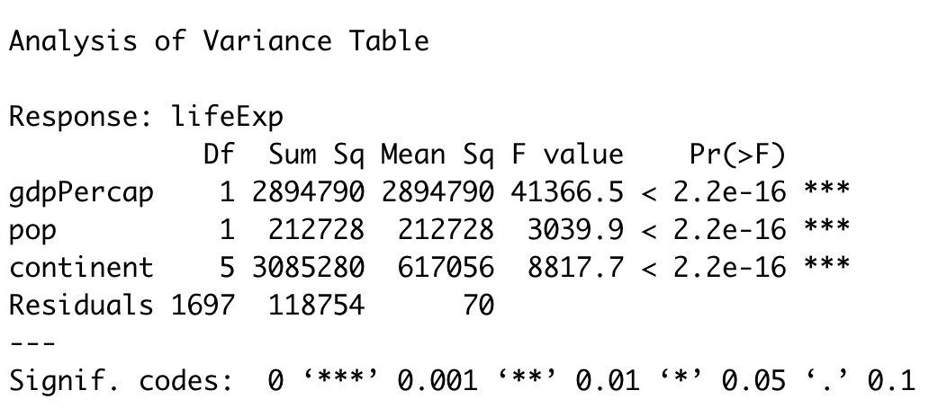
Ancova table

Slide 24
Ancova interpretation
You might read people say:
“Controlling for X, we found a significant difference between groups…”
OK, but be careful
Rule of thumb: If it’s an experiment, it’s OK.
If observational data be cautious and think hard about it.

Slide 25
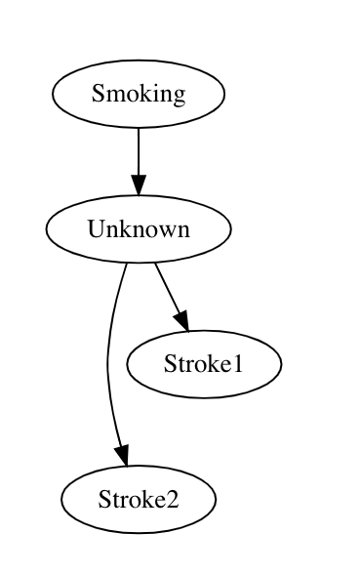
Danger

Slide 26
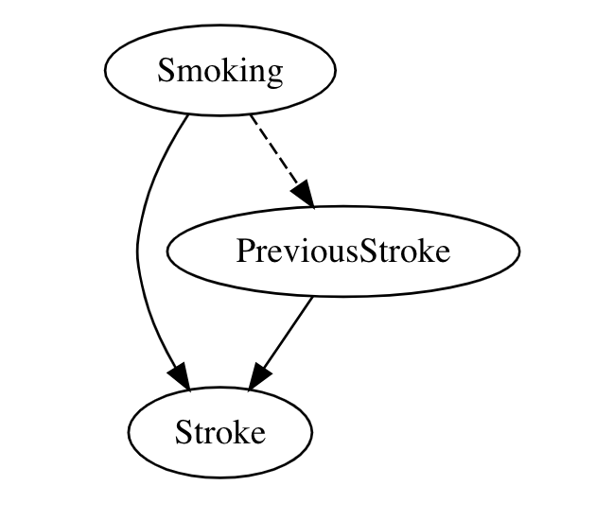
Temptation to run model like this… The effect of smoking gets spread around and mis-estimated.
Read Pearl, Book of Why

Slide 27
Summary
lm( y ~ A )
lm( y ~ A * B )
lm( y ~ X + A ) or
lm( y ~ X + A * B )
THEN
anova(savedmodel) (if no interactions)
car::Ancova(savedmodel, type=3) (if interactions)
Remember to use predict/augment to make predictions (coefs can be tricky).

